Slide 1
British Airways Task-1 Presentation

Slide 2
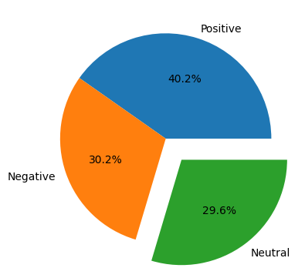
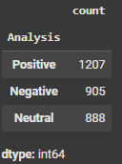

Review Analysis

Slide 3
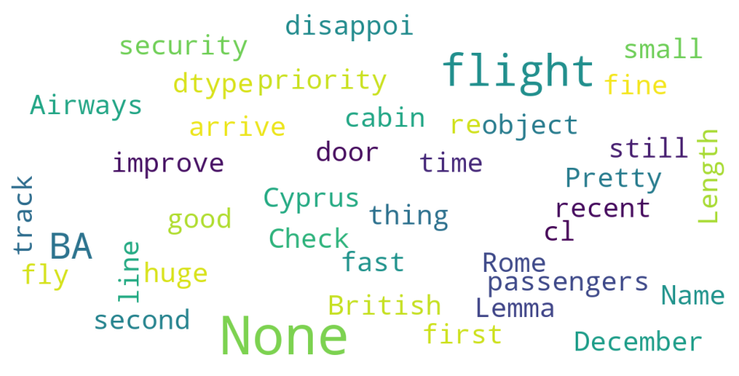
Word Cloud

